Slide 1
Databases
Lecture 4
DML. Database design.

Slide 2
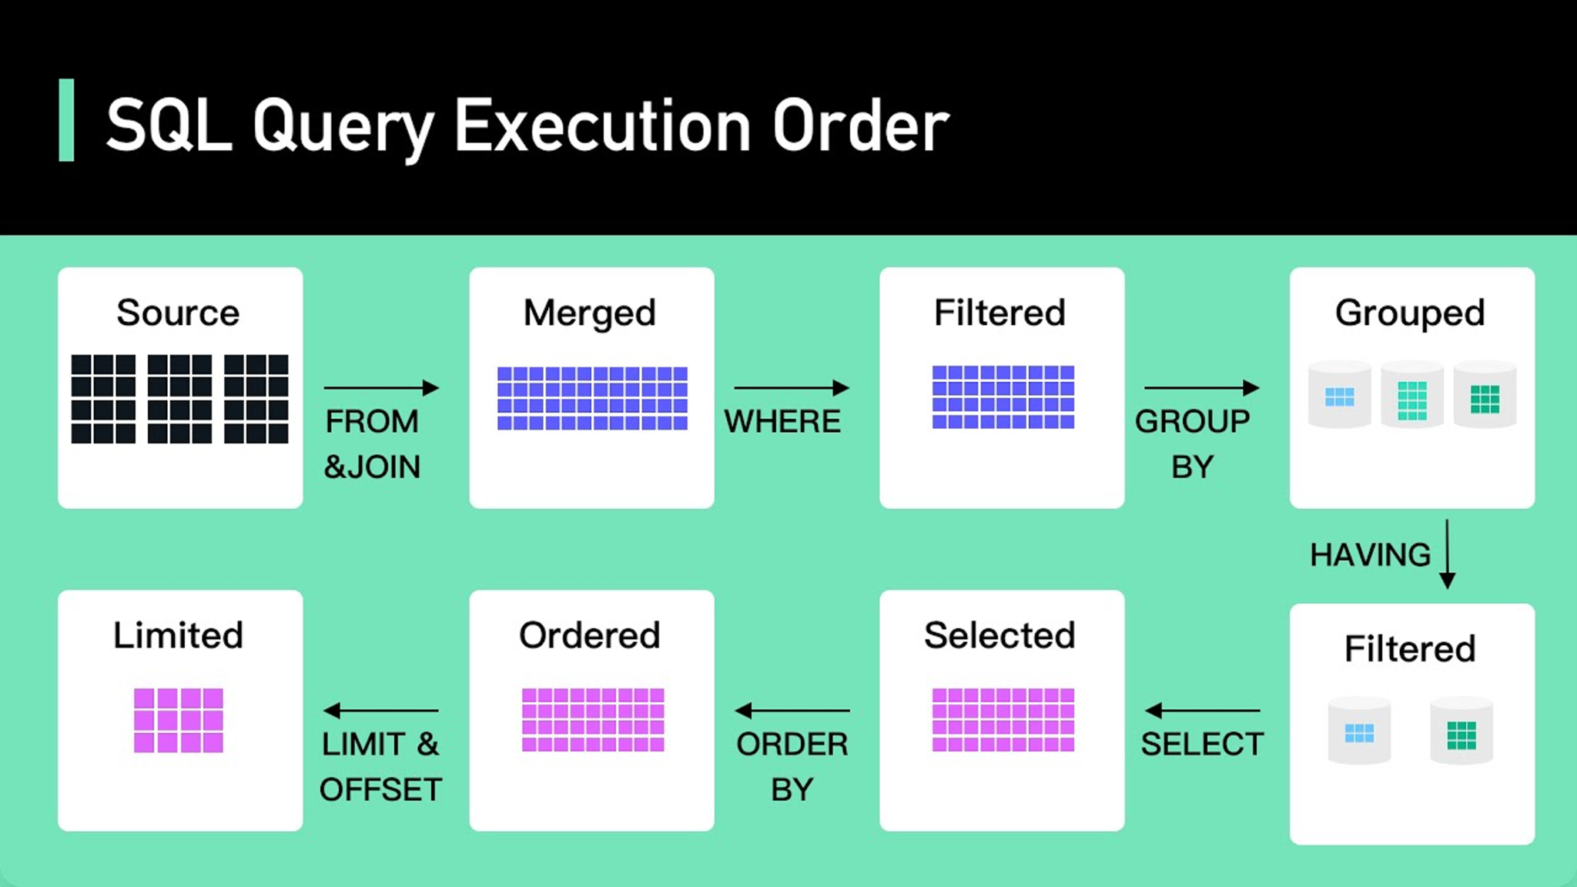
Reminder: the order of execution
FROM & JOIN
WHERE
GROUP BY
HAVING
SELECT
ORDER BY
LIMIT & OFFSET

Slide 3
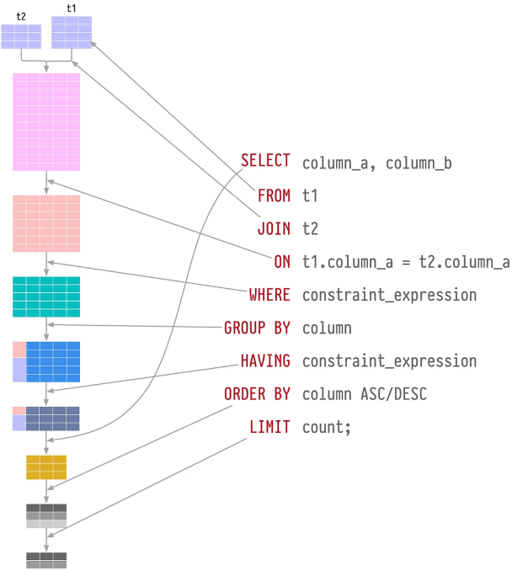

Slide 4
DML: aggregation functions
An aggregate function reduces many input values to a single output value, such as a sum or average
Most aggregate functions ignore NULL values, so rows for which expressions produce one or more NULL values are discarded

Slide 5
SELECT: using aggregation functions
count() -> bigint
the number of records with a known value. If you need to count the number of unique values, you can use count(DISTINCT field_nm)
max() -> same type as input
the largest of all selected field values (!= NULL)
min() -> same type as input
the smallest of all selected field values (!= NULL)
sum() -> numeric
sum of all selected field values (!= NULL)
avg() -> numeric
average of all selected field values (!= NULL)

Slide 6

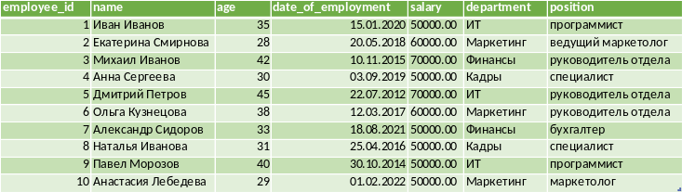
Count
SELECT count(*) as total_rows
FROM new_employees;

Slide 7

Sum
SELECT sum(salary) as total_payments
FROM new_employees;

Slide 8

Max
SELECT max(date_of_employment) AS last_emploee
FROM new_employees;

Slide 9

Min
SELECT min(date_of_employment) AS first_emploee
FROM new_employees;

Slide 10
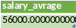
Avg
SELECT avg(salary) as
salary_average
FROM new_employees;

Slide 11
SELECT: GROUP BY + aggregation
When a GROUP BY clause or any aggregate function is present in a query, expressions in the SELECT list generally cannot access non-groupable columns because otherwise the non-groupable column would have to return more than one possible value
Aggregate functions, when used, are evaluated over all rows that make up each group and ultimately produce a separate value for each group

Slide 12
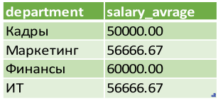
SELECT: example
SELECT department, ROUND(AVG(salary), 2) as salary_average
FROM new_employees
GROUP BY department;

Slide 13
SUBQUERIES
A subquery is a query contained in another SQL expression
(we will call it a containing expression)

Slide 14
SUBQUERIES
scalar
non-scalar

Slide 15
SUBQUERIES
unrelated
linked

Slide 16
SUBQUERIES
Unrelated, i.e. completely self-sufficient and independent of the main query
Are executed before executing the containing expression.
Linked, i.e. refer to the columns of the main query.
The use of aliases is useful for writing such queries.
For cases when the same table is used in the main query and in the subquery the use of aliases is mandatory!
Are executed for each line containing expressions.

Slide 17

Expressions (predicates) of subqueries
If the subquery is non-scalar (returns many values), then special predicates can be applied to it from the outer query:

Slide 18
SUBQUERIES: EXISTS
EXISTS(subquery)
After executing a query, the system checks whether it returns rows in the result. If it returns at least one row, the EXISTS result will be "true", and if it returns none, the result will be "false"
The subquery may not be executed completely, but will end as soon as at least one row is returned. Therefore, “side effects” should be avoided in subqueries
When using the EXISTS predicate, we are not interested in the return value, so in the subquery after the SELECT, as a rule, you can specify an arbitrary value

Slide 19
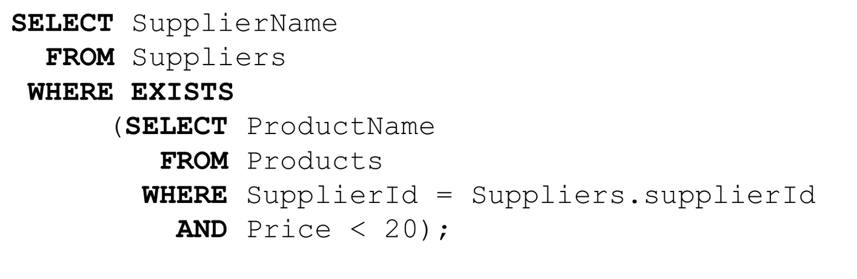
EXISTS: example

Slide 20
SUBQUERIES: IN / NOT IN
IN expression (subquery)
On the right side of this expression, a subquery is specified in parentheses, which must return exactly one column
The evaluated value of the left expression is compared with the values in all rows returned by the subquery. The result of the entire IN expression will be “true” if a row with that value is found, and “false” otherwise (including when the subquery returns no rows at all).
The entire NOT IN expression will result in "true" if only non-matching rows are found (including when the subquery returns no rows at all). If there is at least one matching line, the result will be “false”.

Slide 21
SUBQUERIES: IN / NOT IN
IN expression (subquery)
If the result of the expression on the left is NULL or there are no equal values on the right, and at least one of the values on the right is NULL, the IN construct returns NULL
The request may not be completed completely!

Slide 22
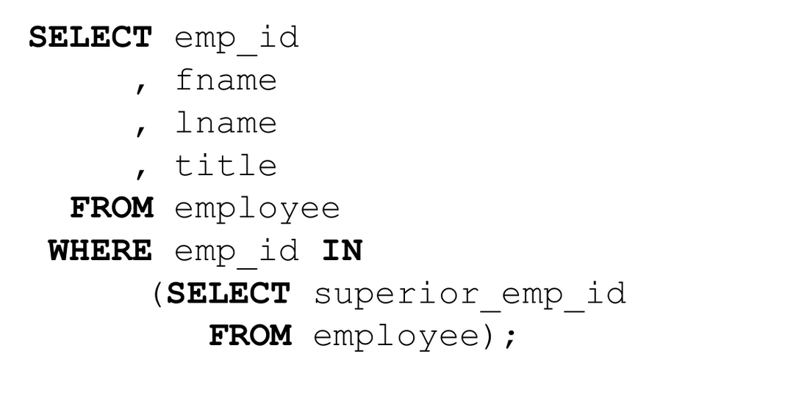
EXAMPLE: IN / NOT IN

Slide 23
SUBQUERIES: ANY / SOME
expression operator ANY (subquery)
expression operator SOME (subquery)
On the right side of the construction, a subquery is written in parentheses, which must return exactly one column. The evaluated value of the left expression is compared with the value in each row of the subquery result using the specified condition operator, which must return a Boolean value
The result of ANY will be “true” if the condition is true for at least one row, and “false” otherwise (including when the subquery does not return any rows)

Slide 24
SUBQUERIES: ANY / SOME
The SOME keyword is a synonym for ANY. The IN construct can also be written as = ANY
If the condition is not satisfied for any of the rows, and for at least one row the conditional operator returns NULL, the ANY construct returns NULL, not false
The request may not be completed completely!

Slide 25
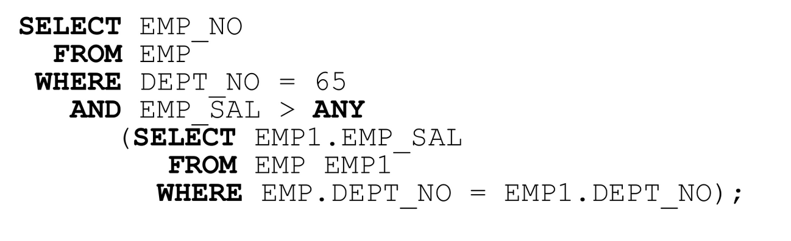
SUBQUERIES: ANY / SOME

Slide 26
SUBQUERIES: ALL
expression operator ALL (subquery)
On the right side of the construction, a subquery is written in parentheses, which must return exactly one column. The evaluated value of the left expression is compared with the value in each row of the subquery result using a specified conditional operator, which must return a Boolean value.
The result of ALL will be “true” if the condition is true for all rows (and when the subquery returns no rows), or “false” if there are rows for which it is false. The result of the expression will be NULL if for none of the subquery rows the comparison result is true, and the minimum for one is NULL
The NOT IN construction is equivalent to <> ALL
The request may not be completed completely!

Slide 27
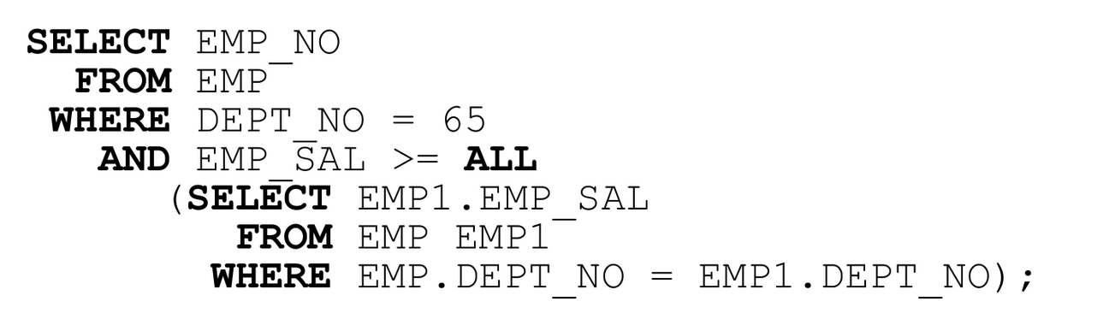
SUBQUERIES: ALL

Slide 28
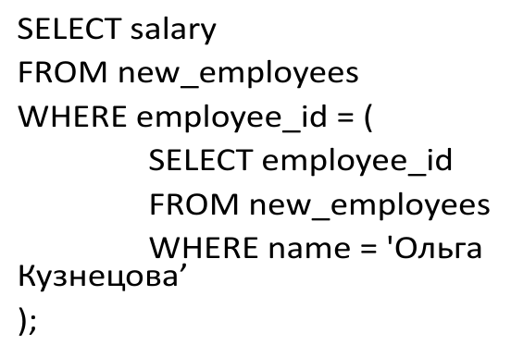
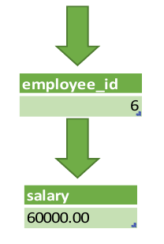
Example: scalar

Slide 29
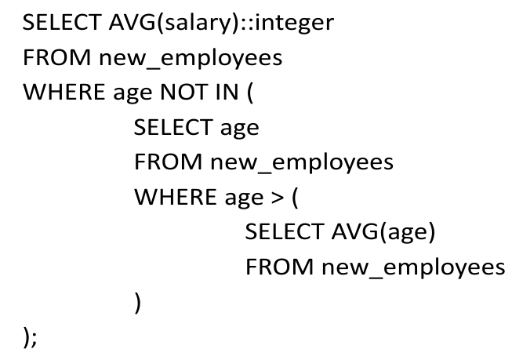
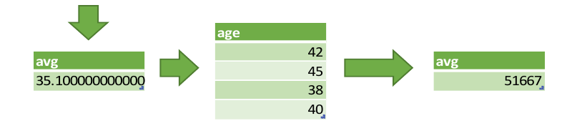
Example: non-scalar

Slide 30
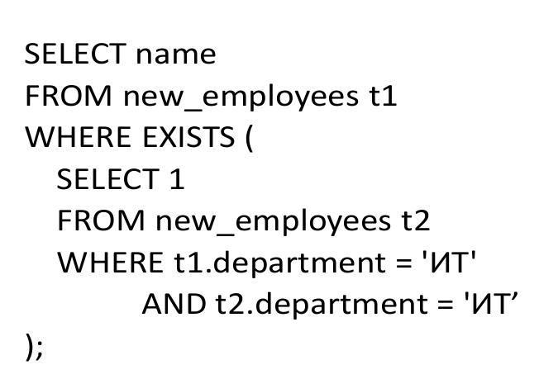
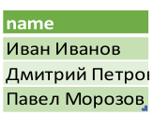
Example: non-scalar

Slide 31
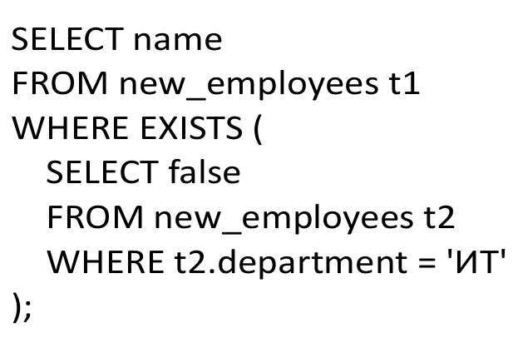
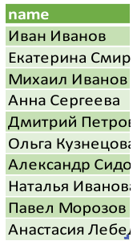
Example: non-scalar, incorrect

Slide 32
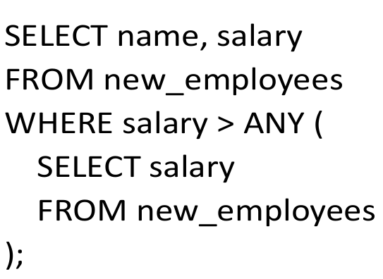
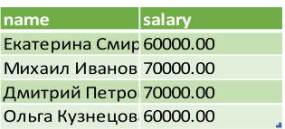
Example: non-scalar

Slide 33
Example: non-scalar

Slide 34

Example: non-scalar

Slide 35
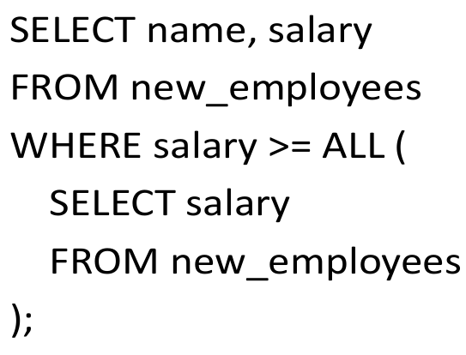
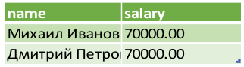
Example: non-scalar

Slide 36
DATABASE DESIGN
– the process of creating a detailed database data model, as well as the necessary
integrity constraints.
A data model is an abstract model that:
Organizes data elements
Describes how they interact with each other
Describes how they interact with objects of the outside world

Slide 37
DESIGN GOALS
keeping all the necessary information
reducing the redundancy and data duplication
obtaining the necessary data upon the request
ensuring database integrity

Slide 38
BASIC DESIGN STEPS
Definition of the subject area and the data to be stored in the database
Defining relationships between different data elements
Imposing a logical structure on the data based on certain ratios
Creating a designed database taking into account the features of the DBMS used

Slide 39
STAGES OF DATABASE DESIGN
Conceptual design (infological)
Logical design (datalogical)
Physical design

Slide 40

STEP 1 DATA DEFINITION
What subject area are we describing?
Full database of goods of Pyaterochka stores
Full customer base of Tinkoff Bank
MIPT educational processes
etc.

Slide 41
CONCEPTUAL DESIGN
A conceptual data model is a description of the main objects and the relationships between them.

Slide 42
STEP 2 DEFINING RELATIONSHIPS
We defined the subject area and highlighted the entities
Relationships need to be established

Slide 43
ER MODEL
ER-model (entity-relationship model) is a data model that allows you to describe conceptual and logical schemes.
Set:
Entities
Connections

Slide 44
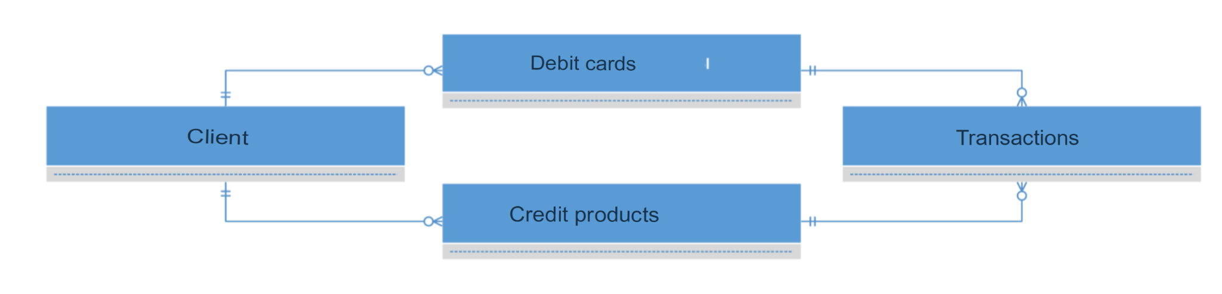
ENTITY NOTATION

Slide 45
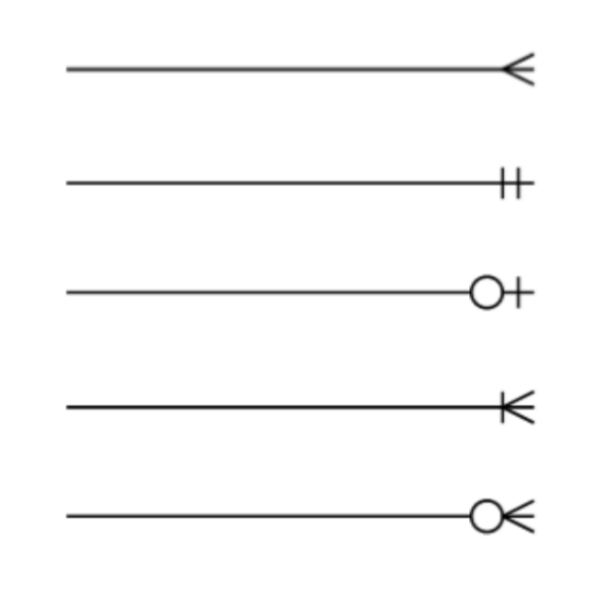
Crow’s Foot notation
✓ Many (strictly more than one)
✓ One and only one
✓ One or zero
✓ Many or one
✓ Many or one or zero

Slide 46
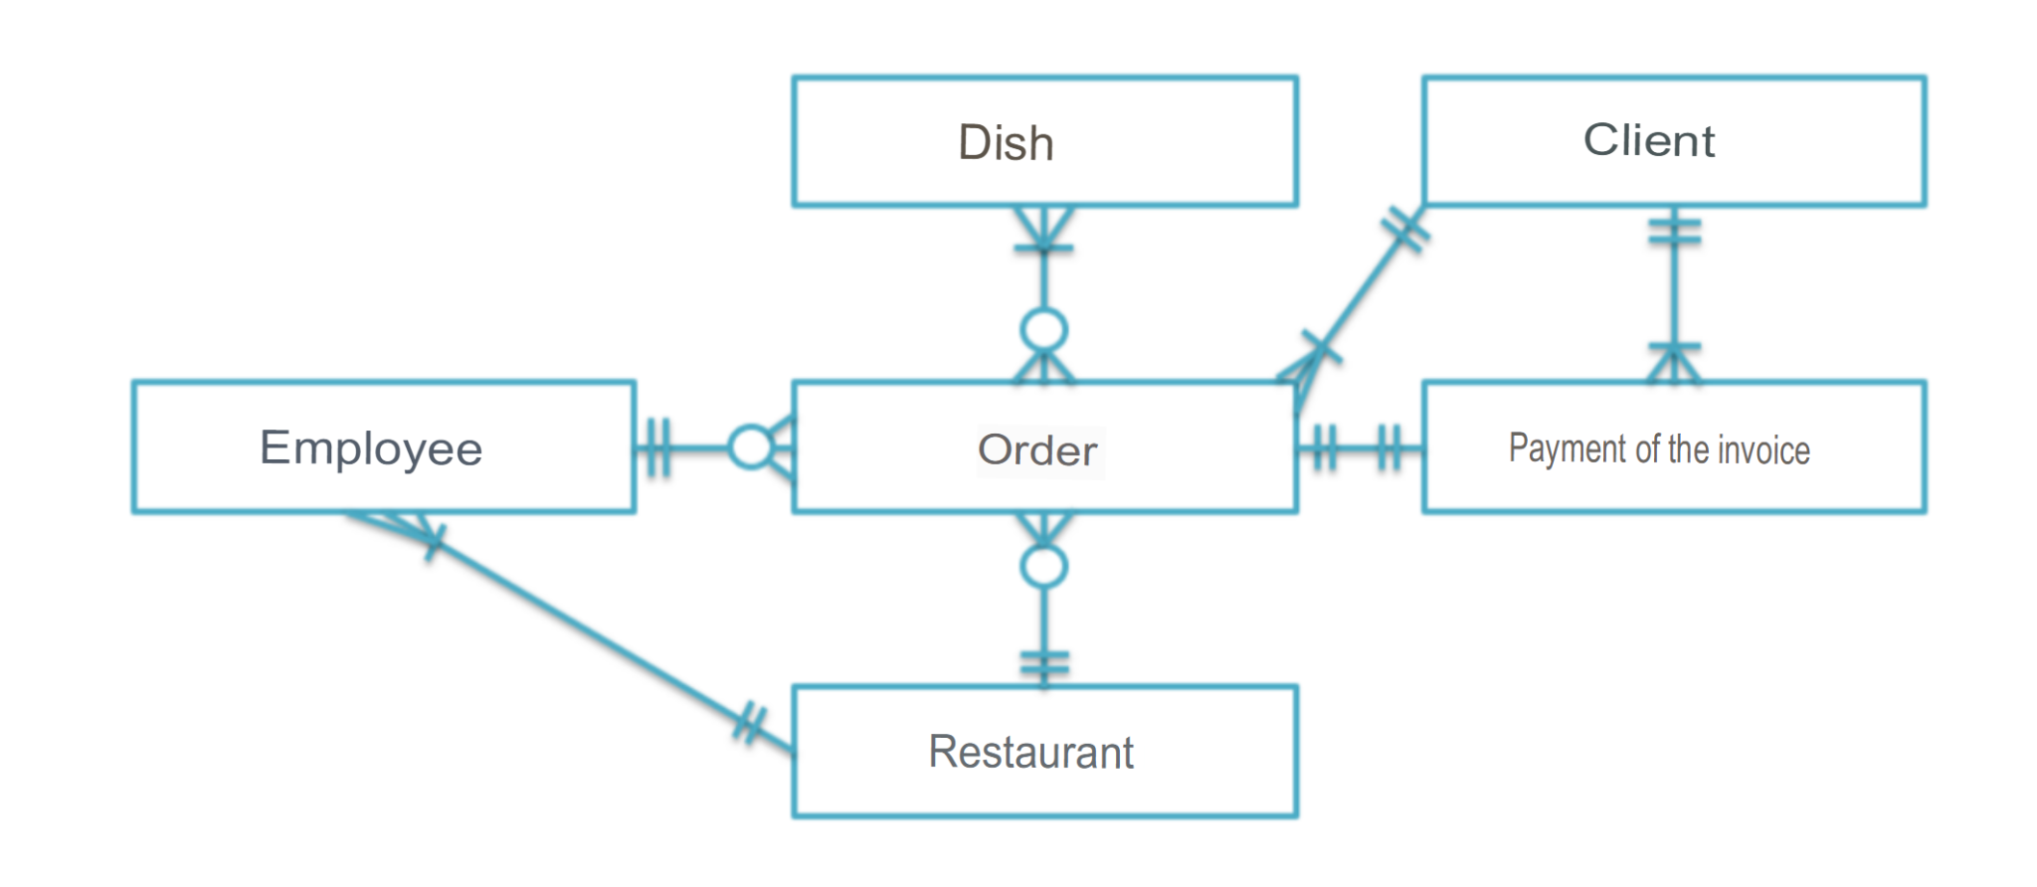
EXAMPLE

Slide 47
STEP 3 CREATING A LOGICAL STRUCTURE
We already have a conceptual scheme
We want to get a higher level of detail:
Clarification of the attribute composition
Clarification of the restrictions imposed on the attribute composition
Normalization of relations
In some cases, it is allowed to specify the attribute type

Slide 48
POTENTIAL KEY
– this is a subset of the attributes of the relationship that meets the requirements of uniqueness and minimality
Uniqueness: there are not and cannot be two tuples of a given relation in which the values of this subset of attributes match
Minimality: there is no smaller subset of attributes in the potential key that satisfies the uniqueness condition

Slide 49
POTENTIAL KEY
From the relationship property: a potential key always exists, even if it includes all the attributes of the relationship
It is acceptable to have multiple potential keys in relation

Slide 50
CLASSIFICATION BASED ON COMMUNITY
Potential key
Simple: consists of exactly one attribute
Composite: consists of two or more attributes

Slide 51
PRIMARY KEY
– this is one of the potential relationship keys selected as the Primary key (PK)
If there is only one potential key in the relation, it will be the primary key
If there are several potential keys, then:
One of them is selected as the primary
The other keys are called alternative keys
The absence of a value is unacceptable

Slide 52
PRIMARY KEY
Theoretically, all potential keys are equally suitable for use as a primary key
In practice, they use the potential key that:
Takes up less storage space
Will not lose its uniqueness over time

Slide 53
SURROGATE KEY
– this is an additional service field that is added to the already existing information fields of the table, the only purpose of which is to serve as a primary key
The value of such a field is generated artificially
Do not look for some deep meaning in it
A key that is based on an already existing field is called natural
A key that is based on a natural key by adding an additional field is called an intelligent key.

Slide 54
SURROGATE KEY
Usually the surrogate key is a numeric field
The values of the surrogate key are generated by an arithmetic progression with a step of 1
In a number of DBMS there is a special data type that automatically generates such a sequence:
PostgreSQL – SERIAL
MySQL – AUTO_INCREMENT

Slide 55
ADVANTAGES OF SURROGATE KEYS
Immutability: filled in with one value once and for all(except in extraordinary situations)
Guaranteed uniqueness: because the value is generated by auto-increment, repetition of values is excluded
Flexibility: since such a key does not carry any informative load, it can be freely replaced
Easier to program: allows you not to tie on the structure of a specific database. Especially convenient for languages with statictyping
Efficiency: more convenient when creating links to other tables

Slide 56
DISADVANTAGES OF SURROGATE KEYS
Vulnerability of generators: by key numbers it is possible to find out the number of new records for a certain period of time
Uninformativeness: manual database check becomes more complicated
Induces the administrator to skip normalization: instead of breaking the relationship into several relationships and carefully taking into account all the connections, the temptation is great to simply create a surrogate key
Optimization issues: the need to maintain both surrogate and natural keys (we will talk about this in Lecture 6)
Unwitting binding of the developer to the behavior of the key generator in a specific DBMS

Slide 57
FOREIGN KEY
Let 1 and 2 be two variable relations, not necessarily different. The foreign key of FK in 2 is a subset of the attributes of variable 2 such that the following requirements are met:
There is a potential PK key in the relation variable 1 such that PK and FK match exactly up to the renaming of attributes
At any given time, each value of FK in the current value 2 is identical to the value of PK in some tuple in the current value 1 In other words, at any given time , the set of all values of FK in 2 is a subset of the values of PK in 1

Slide 58
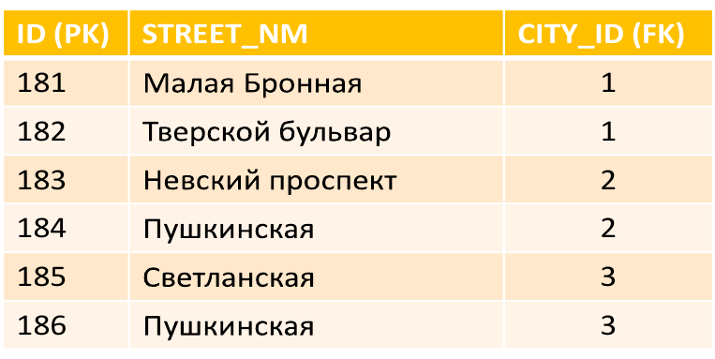
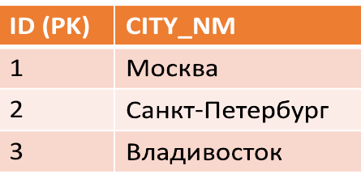
FOREIGN KEY
Relation 1, containing a potential key, is called the main, target, or parent
Relation 2, containing a foreign key, is called subordinate or child

Slide 59
NORMAL FORM
Normal form is a property of a relationship in a relational data model that characterizes it from the point of view of redundancy, potentially leading to logically erroneous results of sampling or data modification
The normal form is defined as a set of requirements that the relation must satisfy
Bringing the database to normal form – normalization
Each following form includes the limitations of the previous ones

Slide 60
DATABASE NORMALIZATION
Intended:
Minimizing logical redundancy
Reducing potential inconsistency
Not intended for:
Decrease/increase in DB performance
Decrease / increase in the physical volume of the database

Slide 61
DATABASE NORMALIZATION
Exclusion of certain types of redundancy
Elimination of some anomalies* Updates
Development of a database project that is:
High-quality representation of the real world
Intuitive
Easy to expand in the future
Simplification of the procedure for applying the necessary integrity constraints

Slide 62
DATA ANOMALIES
The situation in the DB table is such that:
The work with the database is significantly complicated
There are contradictions in the database
Reason:
Excessive duplication of data in the table

Slide 63
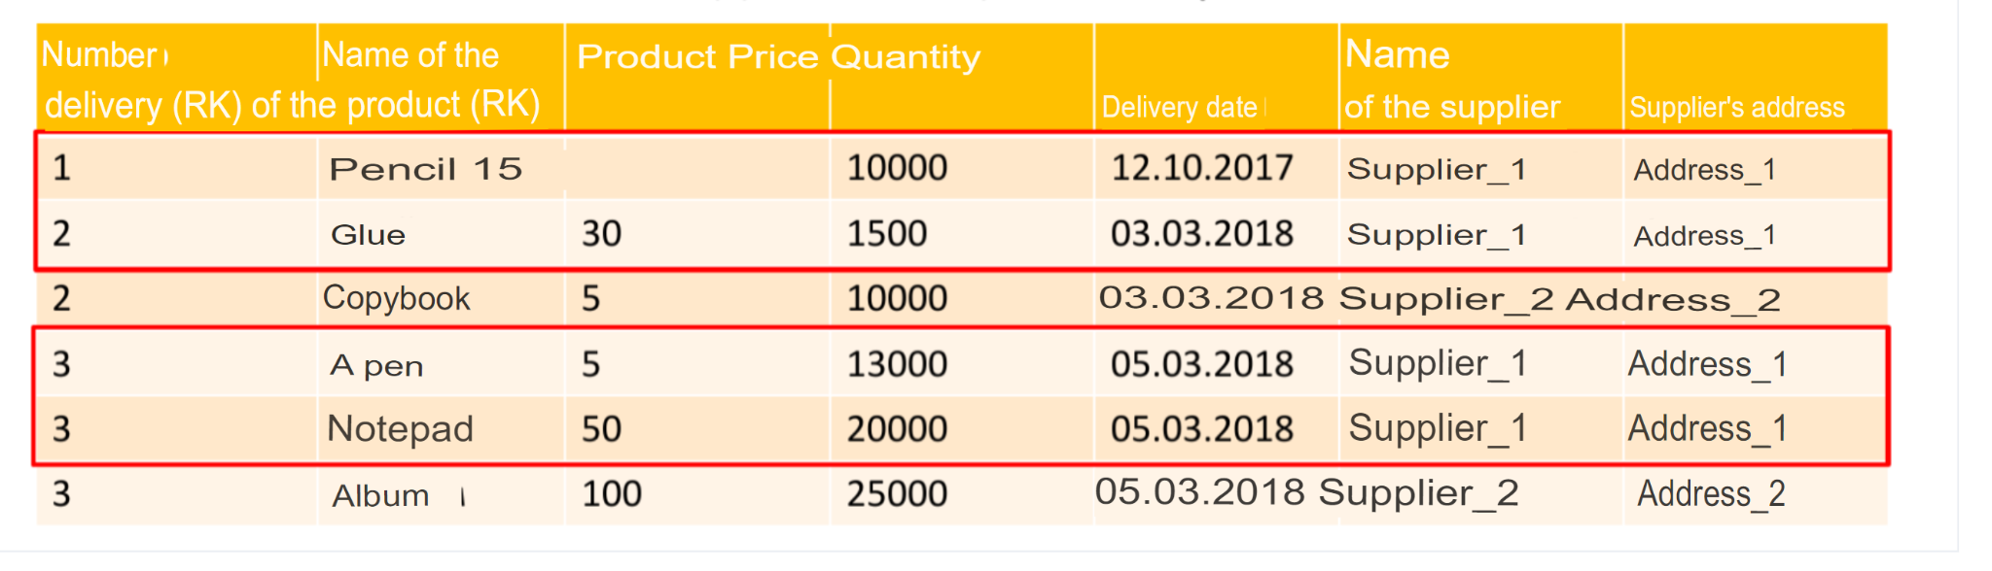
MODIFICATION ANOMALIES
Changing the data of one record entails the need to change the similar data of some more records
Example: to change the distributor 1’s address, we have to change all the rows

Slide 64
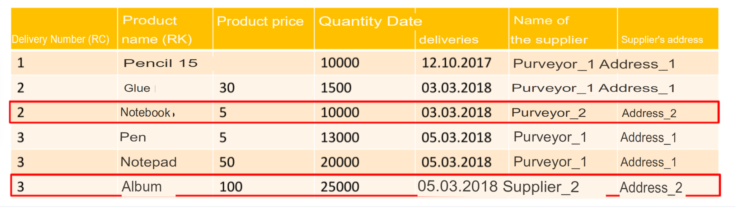
ANOMALIES OF DELETION
Deleting certain records carries the loss of information that you did not want to delete
We want to delete records of deliveries from supplier 2:
We lose all information about supplier 2, including its address

Slide 65
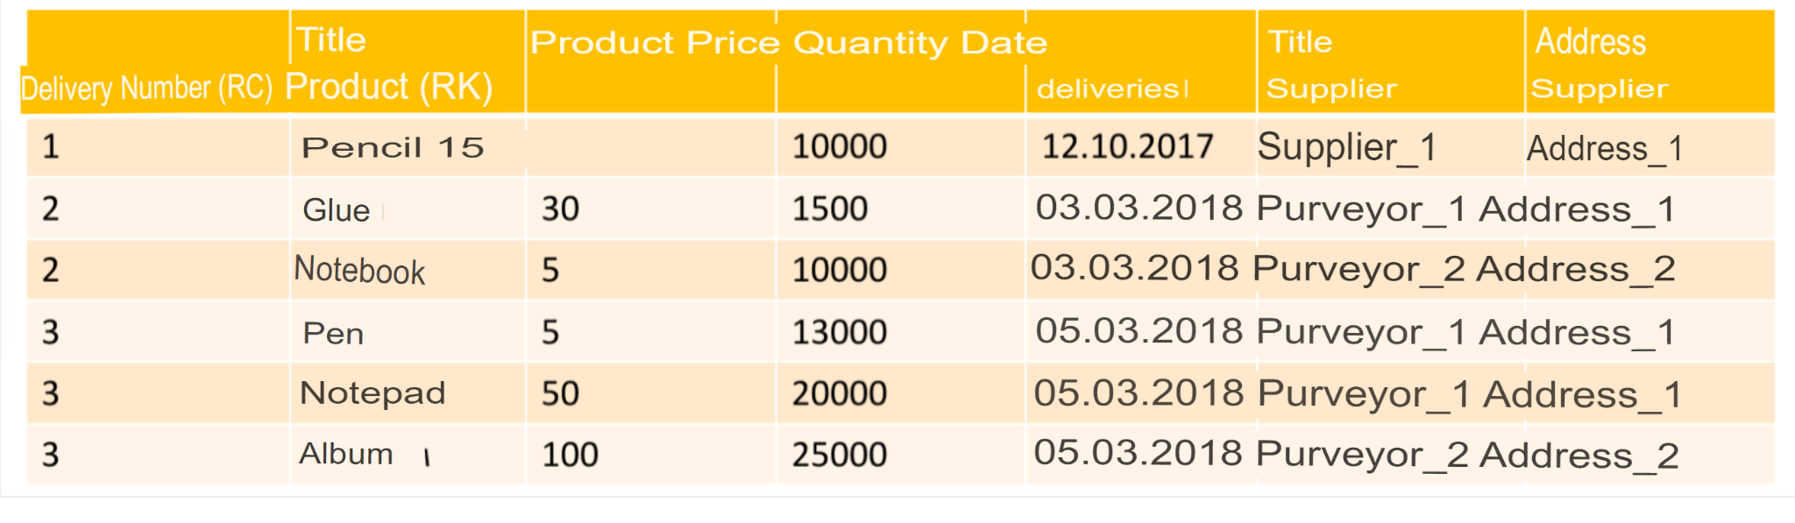
ANOMALIES OF ADDITION
We cannot add a new entry if the values of the primary keys are unknown
We have signed a contract with supplier 3:
We cannot add information about him to the table, because there have been no deliveries yet

Slide 66
DATABASE NORMALIZATION
Database normalization is performed by decomposition of the relation
Decomposition – decomposition of the original variable of the relation into several equivalent
Decomposition is the reverse of a compound
Decomposition is called lossless or correct if it is reversible

Slide 67
NORMAL FORMS
First Normal Form (1NF)
Second Normal Form (2NF)
Third Normal Form (3NF)
Boyce-Codd Normal Form (BCNF)
Fourth Normal Form (4NF)
Fifth Normal Form / Projection-junction Normal Form (5NF/PJNF)
Domain-key Normal Form (DKNF)
Sixth normal Form (6NF)

Slide 68
THE FIRST NORMAL FORM
A relation variable is in the first normal form if and only if the values of all attributes of the relation are atomic.
A relation is in 1NF if all its attributes are simple. All domains used contain only scalar values.

Slide 69
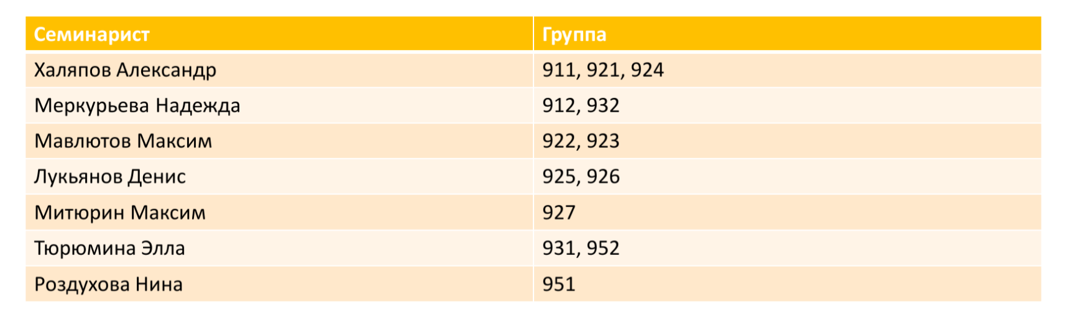
EXAMPLE

Slide 70
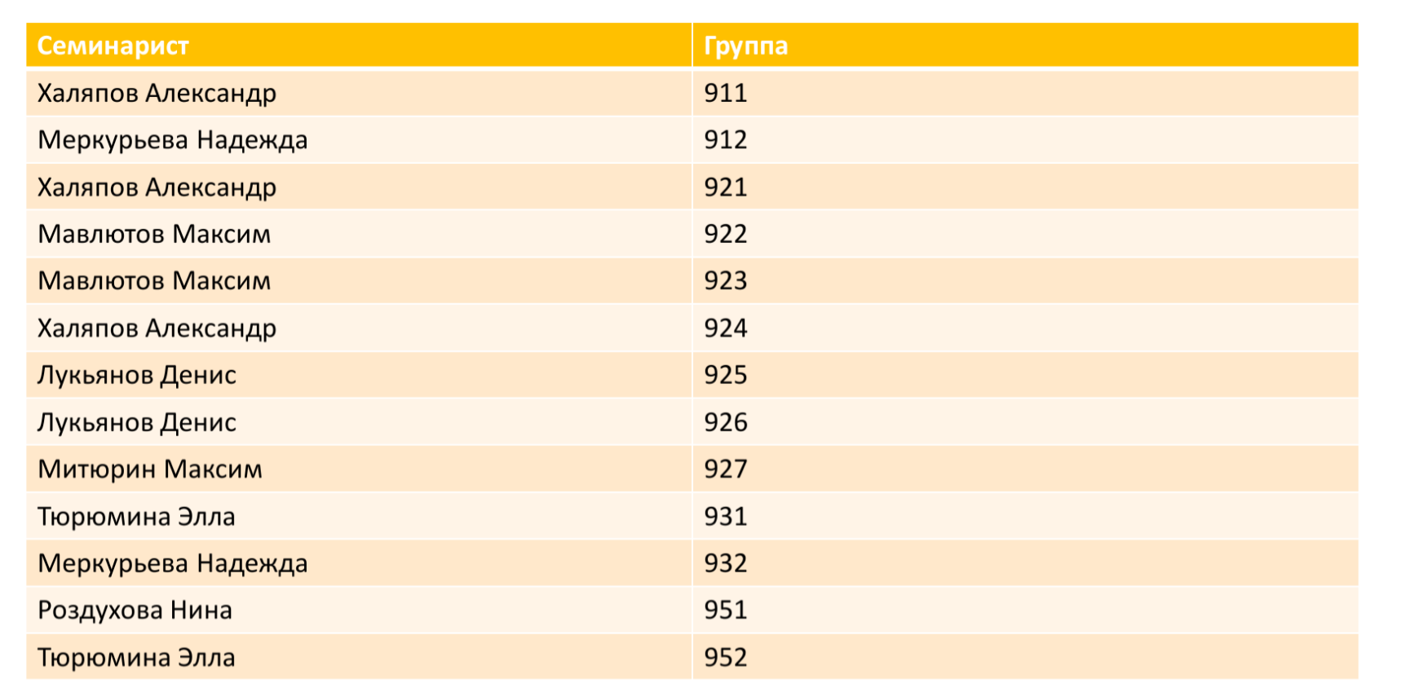

Slide 71
THE SECOND NORMAL FORM
A relation variable is in the second normal form if and only if it is in the first normal form, and each non-key attribute is minimally functionally dependent on a potential key
The functional relationship between the sets of attributes X and Y means that for any valid set of tuples , the following is true in this respect: if two tuples coincide in the value of X, then they coincide in the value of Y
Minimal functional dependency means that the primary key does not contain a smaller subset of attributes, relations which can also be derived from this functional dependency

Slide 72
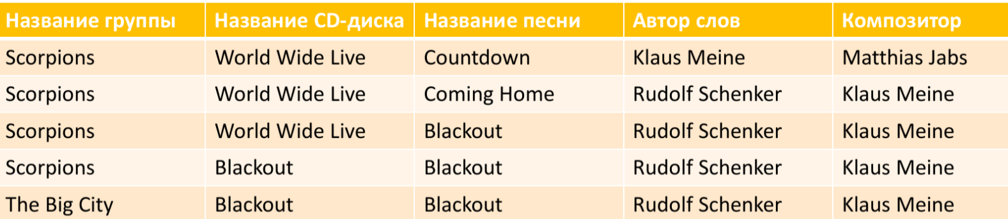
Example
Author and Composer depend only on Group and Song, not on CD name

Slide 73
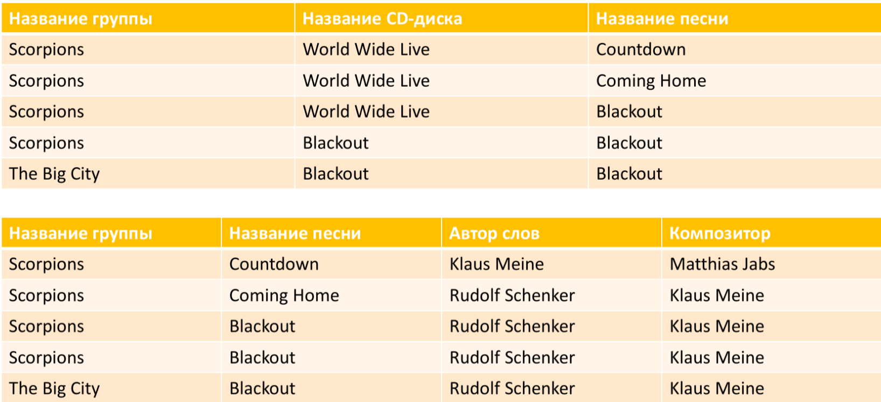

Slide 74
THE THIRD NORMAL FORM
A relation variable is in the third normal form (3NF) if and only if it is in the second normal form, and each non-key attribute is non-transitively functionally dependent on the primary key
In other words, each non-key field must contain information about the key, the full key, and nothing but the key

Slide 75
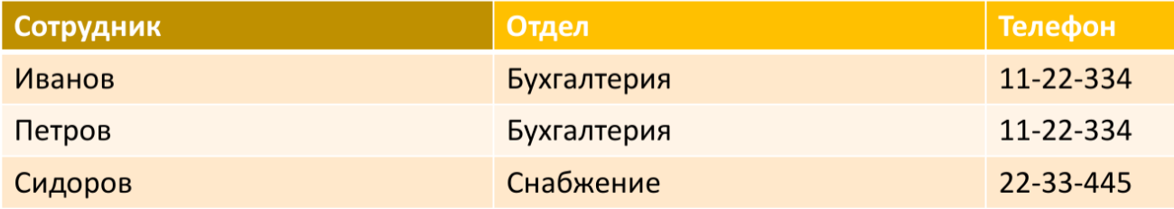
Example

Slide 76
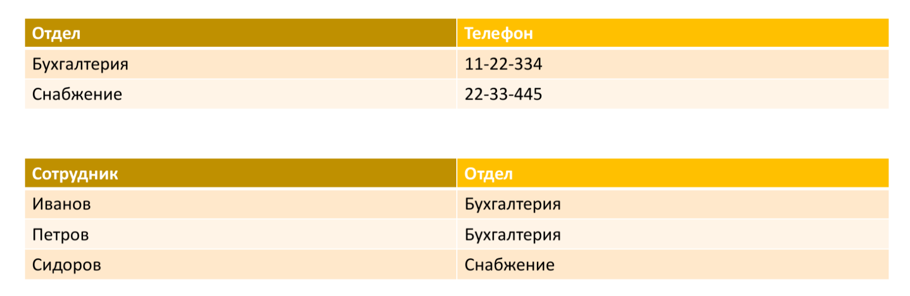
Example

Slide 77
WHY DO WE NEED THAT?
Helps beginners create DBs that aren’t so bad
Helps avoid typical mistakes
Develops the habit of creating the right databases and not putting the design off for later
Gradually develops design skills, without a strong connection to normal forms

Slide 78
STEP 3 CREATING A LOGICAL STRUCTURE
We already have a conceptual scheme
We want to get a higher level of detail:
Clarification of the attribute composition
Clarification of the restrictions imposed on the attribute composition
In some cases, it is allowed to specify the attribute type

Slide 79
LOGICAL DATA MODEL
The logical data model is an extension of the conceptual data model by defining attributes, descriptions and constraints for entities, partially clarifies the composition of entities and the relationships between them.

Slide 80
LOGICAL DATA MODEL
Allows going beyond the conceptual model
Is a prototype of a future physical model
Does not take into account the specifics of any particular DBMS
ER notation is also used for illustration

Slide 81
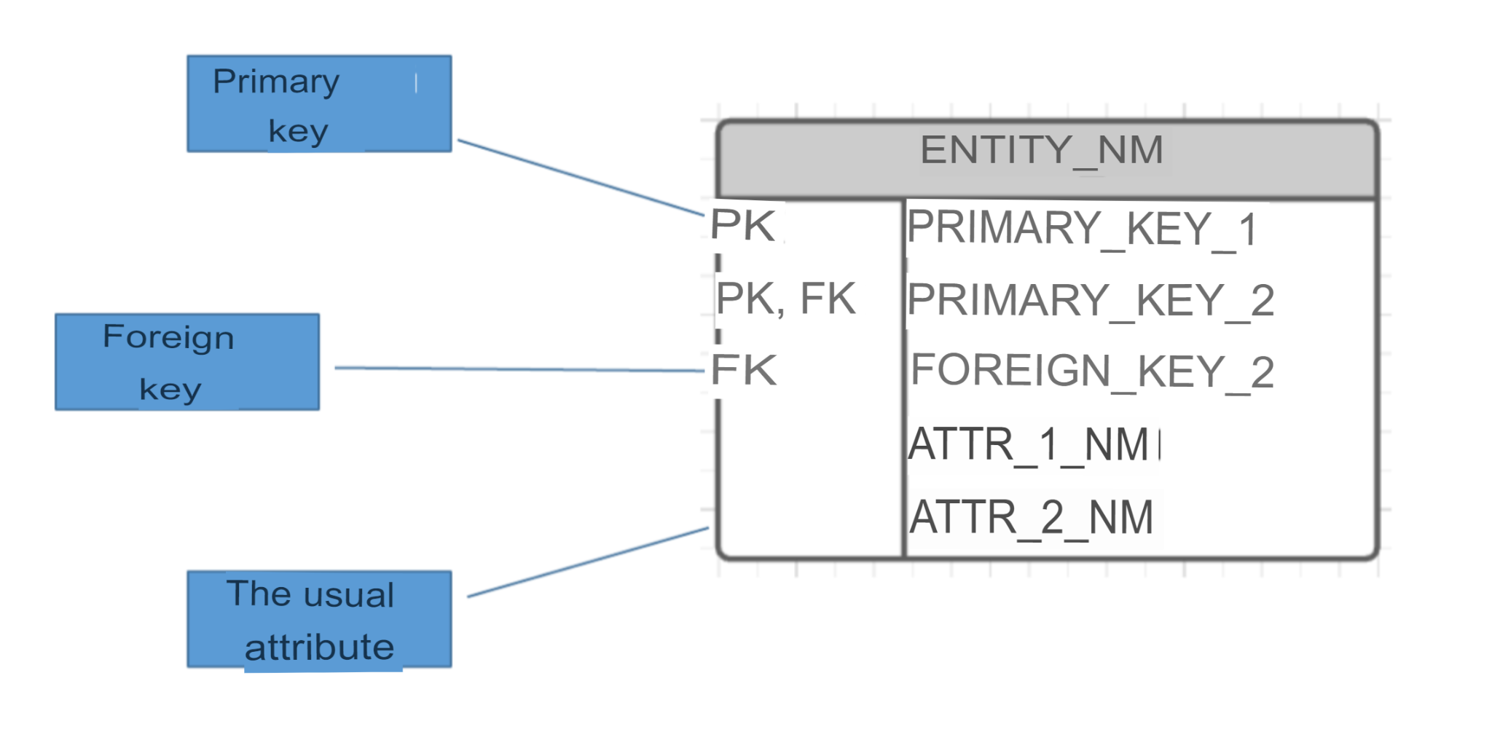
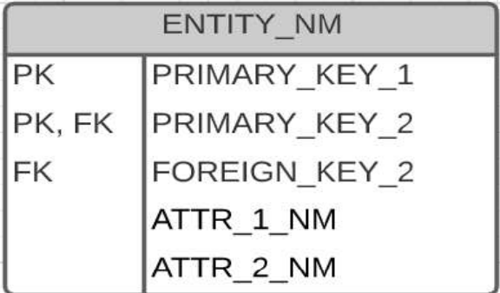
ER notation “Entity”

Slide 82
